Slide 1
Load Shapes:
Past, Present, and Forecast
Mike Welch, Planning Engineer
SRP (Free) Lunch & (Hope To) Learn
July 29, 2016

Slide 2
What is a load shape?

Slide 3
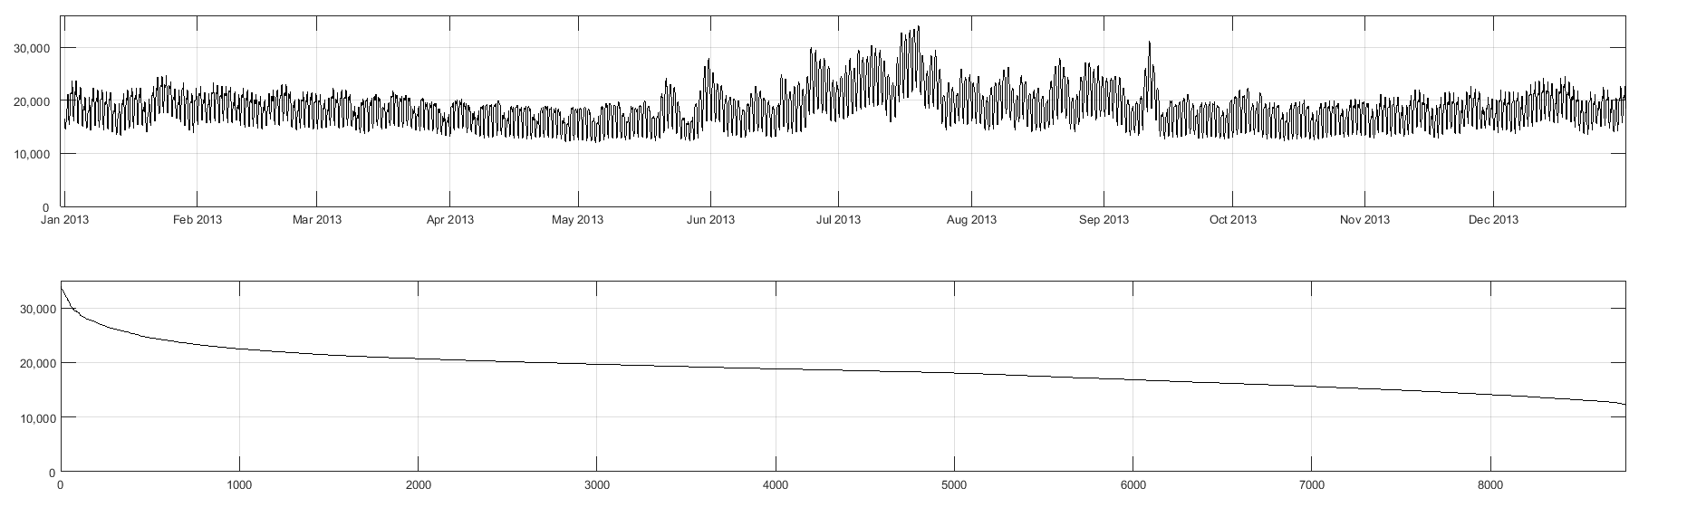
What is a load shape?

Slide 4
What is a load shape?

Slide 5
What is a load shape?

Slide 6
“That’s great, but what goes into the model?”

Slide 7
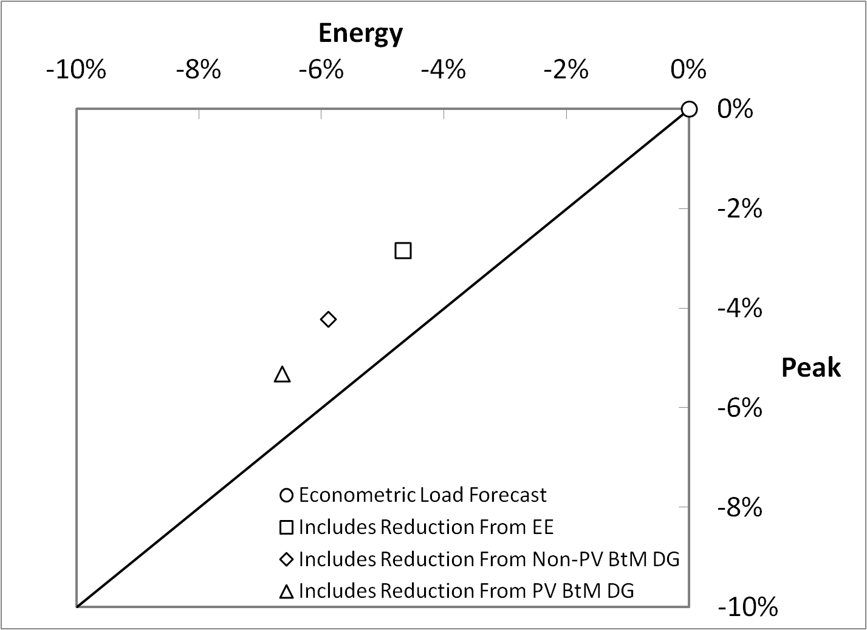
Introducing the Load Forecast
Four Unique Forecasts
  Different profiles
  Varying Peak/Energy Ratio
Only PV BtM DG is modeled discretely
Reduction Relative to Econometric Load Forecast

Slide 8
Introducing the Load Forecast
Each Forecast Contains
  Annual Energy (Zonal)
  Summer Peak (Zonal, NYCA, G-J)
  Winter Peak (Zonal, NYCA, G-J)

Slide 9
Application of Load Forecast Uncertainty
0.0062
0.0606
0.2417
0.3830
0.2417
0.0606
0.0062

Slide 10
Usage of Historic Load Shapes
Historic shapes are tangible
Previously, we solely used the 2002 load shape
Presently, we use this scheme:
LFU Bin | Load Year | Weight
1 | 2006 | 0.0062
2 | 2002 | 0.0606
3 | 2007 | 0.2417
4 | 2007 | 0.3830
5 | 2007 | 0.2417
6 | 2007 | 0.0606
7 | 2007 | 0.0062

Slide 11
“Wow, that’s really cool! How can we improve?”

Slide 12
Refine Forecast Application & Adjustment
Current Method:
  Fit zonal peak forecast by scaling all hours pro rata
Proposed Alternative:
  Develop adjustment function to apply zonal peak forecast
    (this applies to load modifiers, such as Energy Efficiency too)
    Focus adjustment on peak hours, less elsewhere
    Implicit energy match

Slide 13
Refine Forecast Application & Adjustment
Current Method | Proposed Alternative

Slide 14
Refine External Load Model
Current Method:
  Use multiple zonal load profiles across the LFU Bins
Proposed Alternative:
  Utilize a flattened load shape by month or season
    Removes variability and enforces conservatism (always at peak)
    Reduces data management concerns

Slide 15
Refine External Load Model - PJM
Notes:
-.7 from sides, -.3 from top, increase size 20%, offset horizontally 10.54” from center, offset vertically 3” from left corner

Slide 16
Refine External Load Model - ISONE

Slide 17
Refine External Load Model - IESO

Slide 18
Refine External Load Model - HQ

Slide 19
Stop Using Multiple Historic Load Shapes
Current Method:
  Use multiple zonal load profiles across the LFU Bins
Proposed Alternative:
  Use a single zonal load profile across all LFU Bins
    Reduces data management concerns
    Loss of Load events are typically limited to >99% percentile loads
    Ability to ‘track’ events across LFU Bins is presently limited

Slide 20
Investigate Granularity of LFU Multipliers
Current Method:
  Scalar values are applied to whole capability periods
Alternative Methods:
  Apply scalar multipliers by month
  Apply scalar multipliers to top N peak hours with input preprocessor and use Multiple Load Shape feature
    Same mechanic as load forecast adjustment proposal

